Slide 1
Remotely Controllable Driverless Vehicle Equipped With Computer Vision System
PRESENTED BY
Student Name: Masud Ahmed Rifat
ID no : 1509007
SUPERVISED BY
Md. Abdur Rahman
Lecturer
Department of Mechatronics & Industrial Engineering

Slide 2
Introduction

Slide 3
Objectives
Develop a prototype car with computer vision system
Integrate automatic lane detection
Develop automatic lane following control
Develop remote control of the car

Slide 4
Project Flow
Project Flow
Prototype Car with Vision support
Road Detection
Road Driving
Additional Remote Control

Slide 5
Scopes
Automation in car includes all the components of mechatronics, like hardware, software, intelligence
Reduce traffic accidents caused by human error
Increase safety on the road
Collaborate in the advancement of car technology
The prototype can be used to test more advanced features in physical world rather than in simulation.

Slide 6
Literature Review
Author | Title | Contribution
Hummel, R. [1] | Image enhancement by histogram transformation | Suggested a number techniques makes use of easily computed local context features by each point’s gray level during histogram transformation.
J. P. Gonzalez and U. Ozguner [2] | Lane detection using histogram-based segmentation and decision trees | Exploits the characteristics of the gray level histogram of the road to detect lane markers.

Slide 7
Literature Review
Author | Title | Contribution
P. Pramkeaw and C. Thongchaisuratkrul [3] | Automated Driving System of Lane Detection Using Image Processing Techniques | A system that is mostly accurate in an environment where there is no objects or obstruction, the road is clearly seen and the light is not too bright.
Gurjashan Singh Pannu, Mohammad Dawud Ansari and Pritha Gupta[4] | Design and Implementation of Autonomous Car using Raspberry Pi | Uses Hough line transformation. They also have an extra feature of region of interest.

Slide 8
Literature Review
Author | Title | Contribution
N. P. Pawar and M. M. Patil [5] | Driver Assistance System based on Raspberry Pi | Used Hough line transformation for finding lane lines and gave satisfactory results. They also compressed there video before streaming. Network bandwidth made a significant impact on video transmission.
Raja Muthalagu, Anudeepsekhar Bolimera, V. Kalaichelvi[6] | Lane detection technique based on perspective transformation and histogram analysis for self-driving cars | Preprocessing of the image. Both Sobel operator and color thresholding is used. Preprocessing is computationally expensive.

Slide 9
Methodology

Slide 10
System Overview
Power
Raspberry pi
(Computer)
Camera
(Input)
Motor Driver
(Output)
Program Logic

Slide 11
System Overview (Continued)
The system is composed of four major sections:
Camera for real time environment image input
Computer for central processing.
Power management system
Two wheel rear drive.

Slide 12
Image Processing Pipeline
Capture Frame
Convert to HSV Color space
Binary Thresholding
Base Point Average
Histogram
Warp Perspective

Slide 13
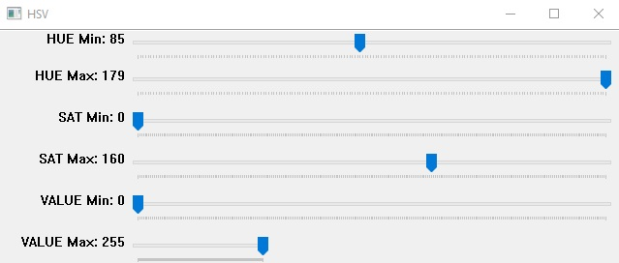
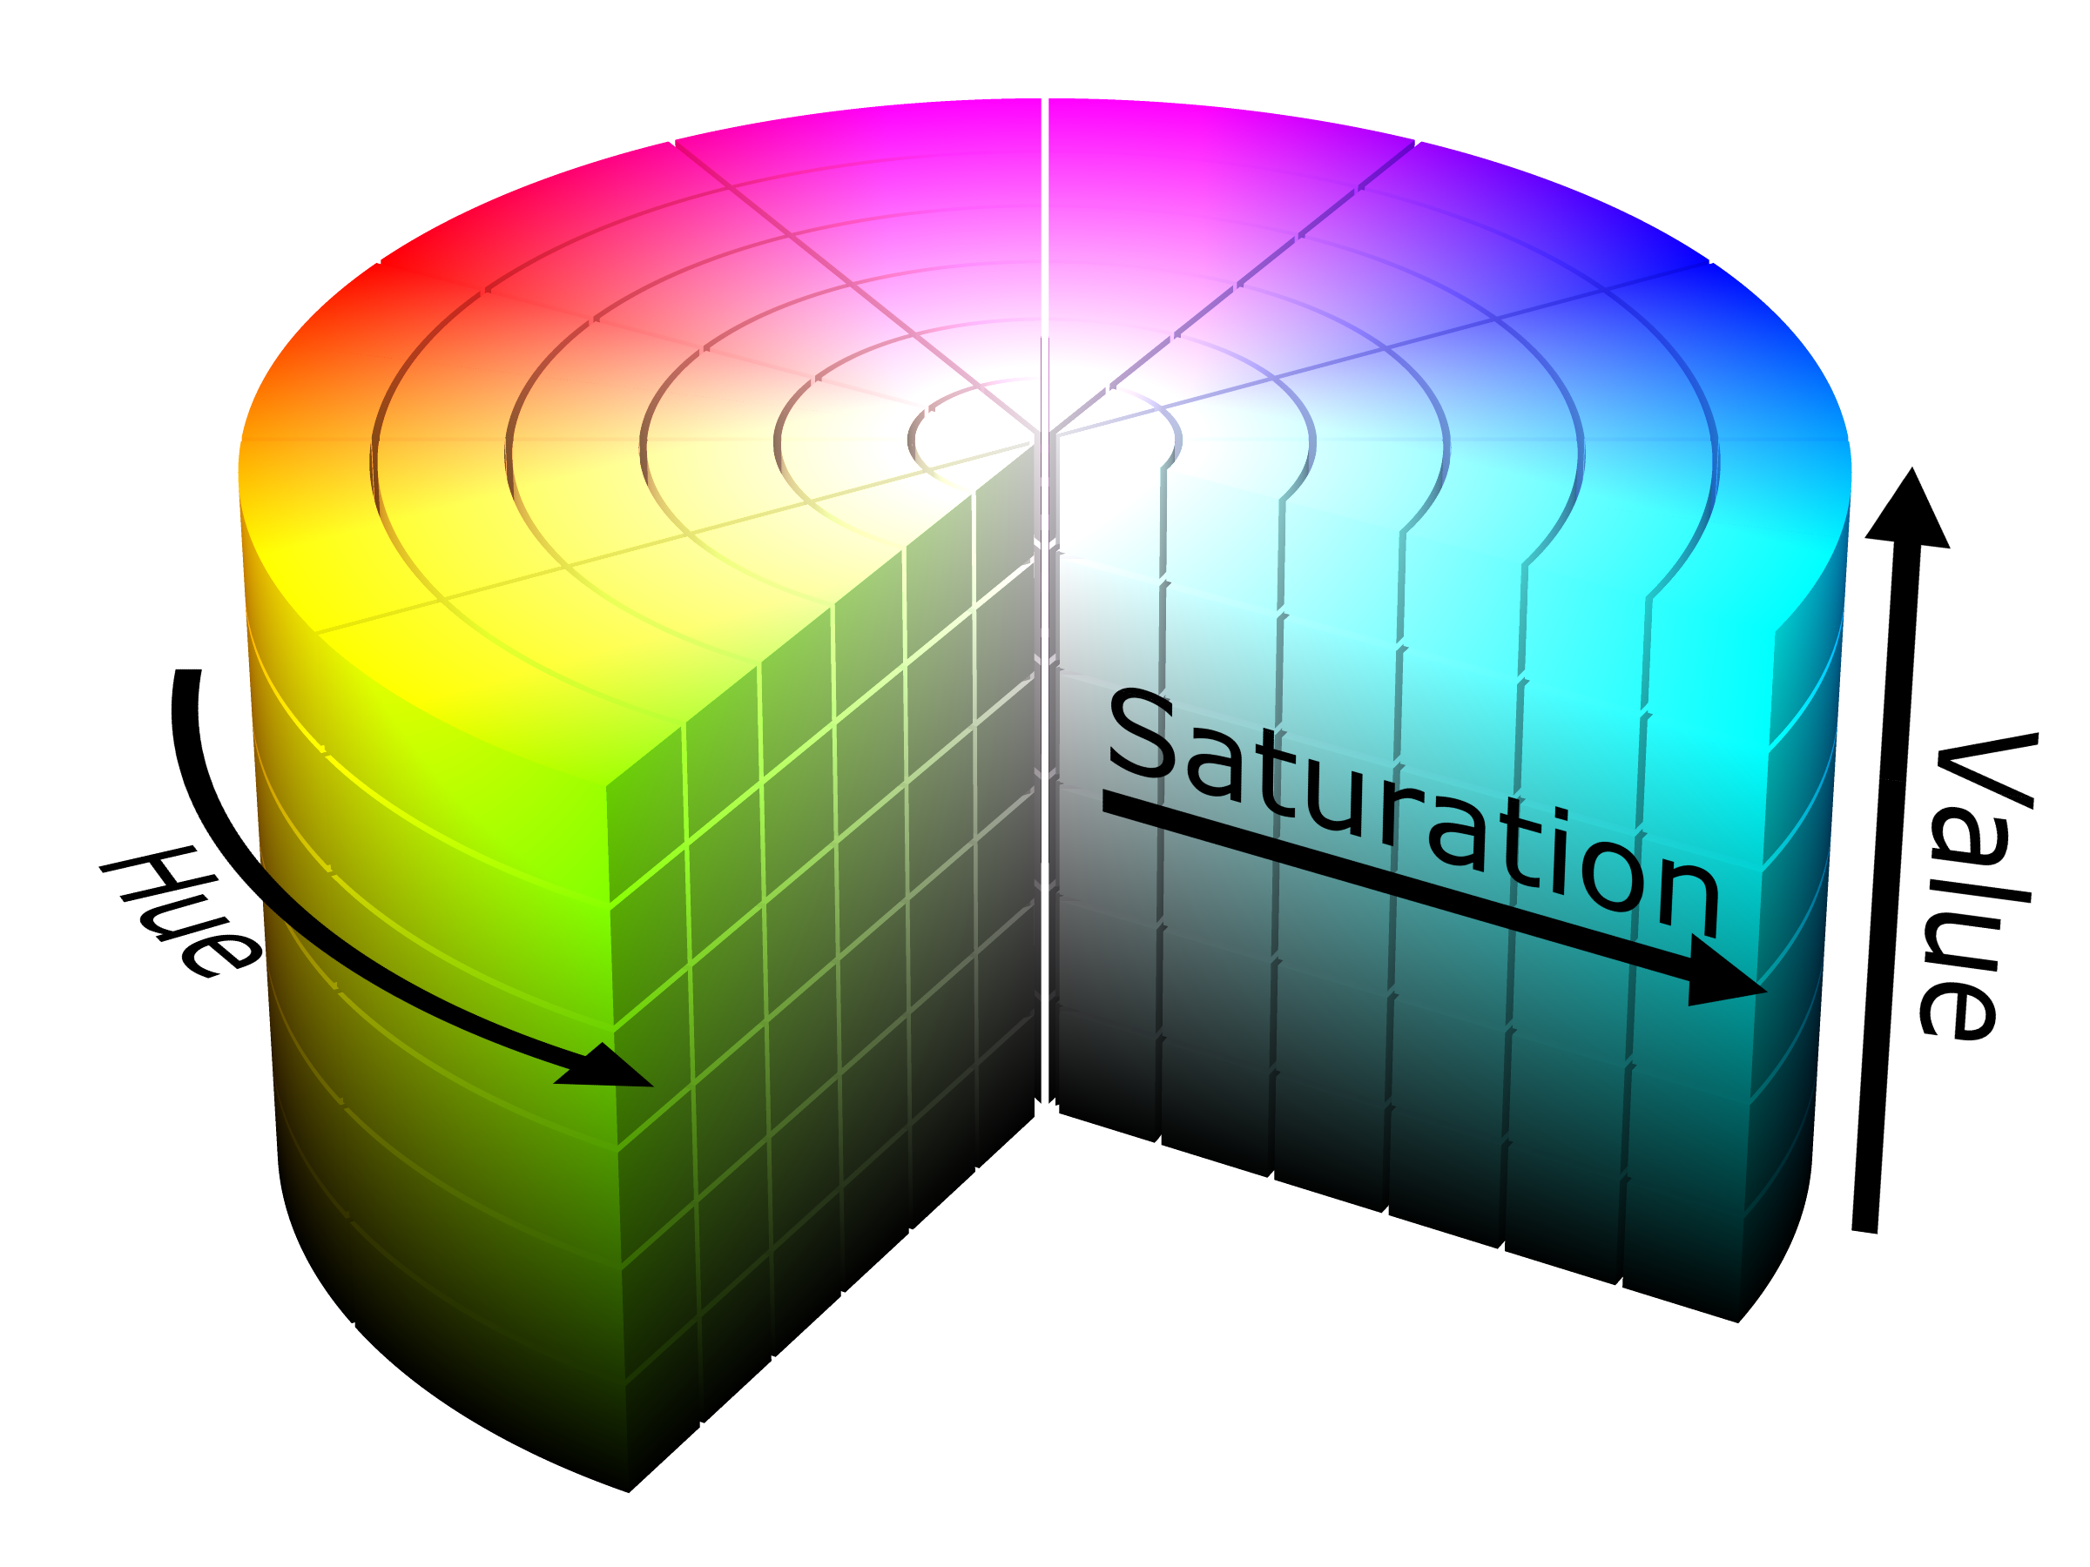
Thresholding
HSV Color Selection
HSV Color Space [7]

Slide 14
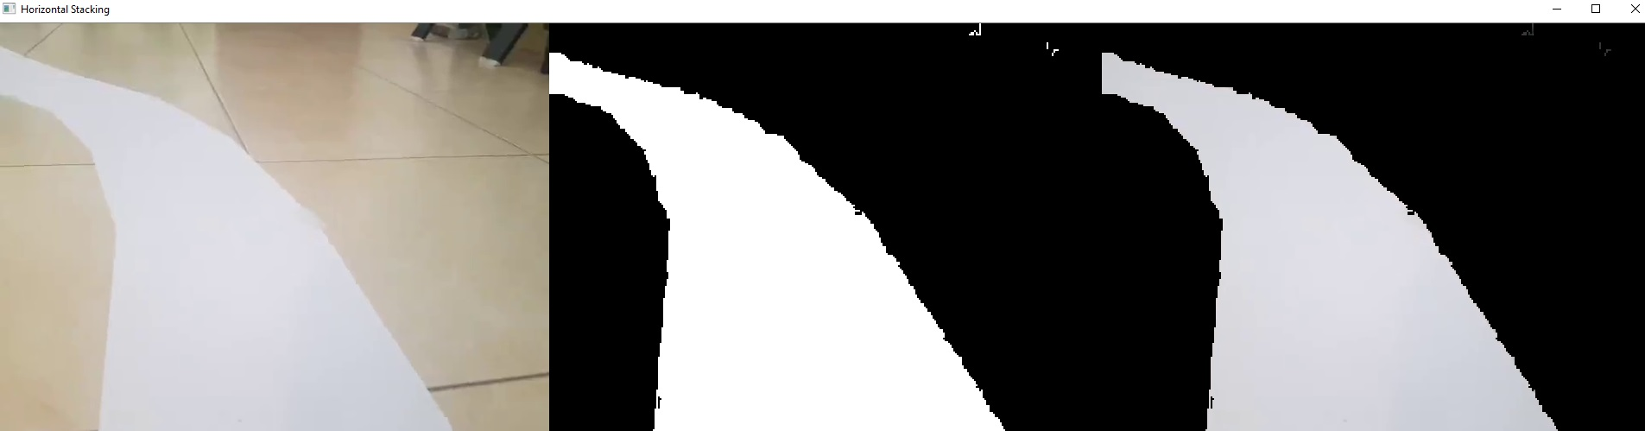
Thresholding and Binary Masking
Original Image
HSV Thresholded
Binary Masked (0,1)

Slide 15
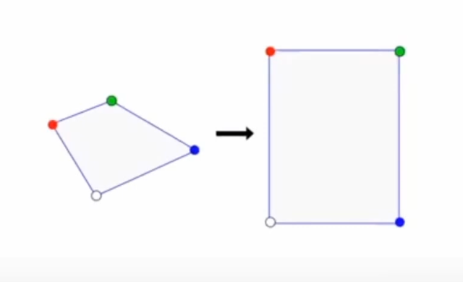
Warp Perspective / Birds Eye
OpenCV function is “Perspective Transformation”
Corrects error caused by camera angle alignment
Required for Correct angle calculation.

Slide 16

Warp Effect
Original Image with points
Binary Image
Warp

Slide 17
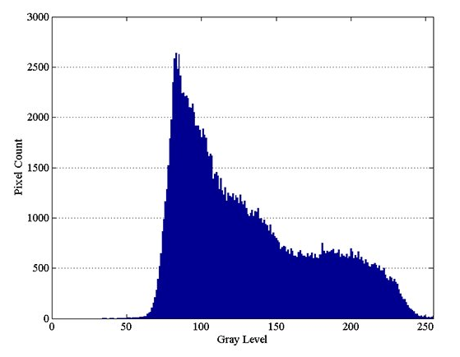
Histogram
Approximate representation
Distribution of numerical data
Used for continuous data
Fig: Histogram [8]

Slide 18
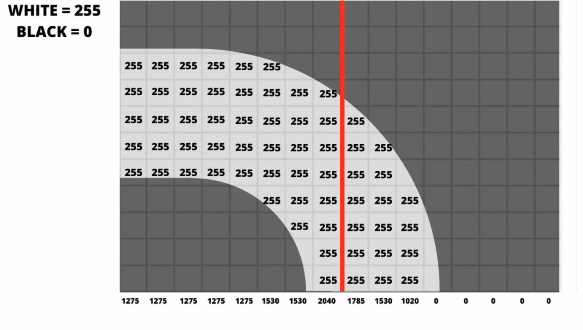

Histogram
Pixel Summation[9]
Histogram Visualization

Slide 19
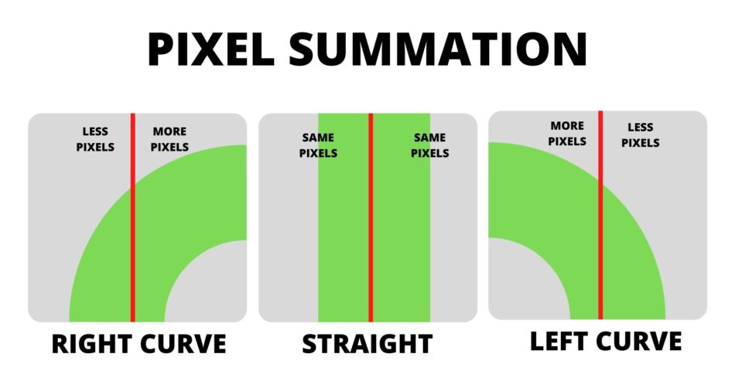
Decision Logic
Calculate average in the lower region.
Determine average point location
Locate middle line
If more pixels is on the right side, move right and vice versa
[9]

Slide 20
Decision / Logic Flow
Capture
Determine direction
Left
Decision
Right
Increase Right wheel speed
Increase Left wheel speed
Zero curvature
Apply same speed on Both wheel
Repeat from capture

Slide 21
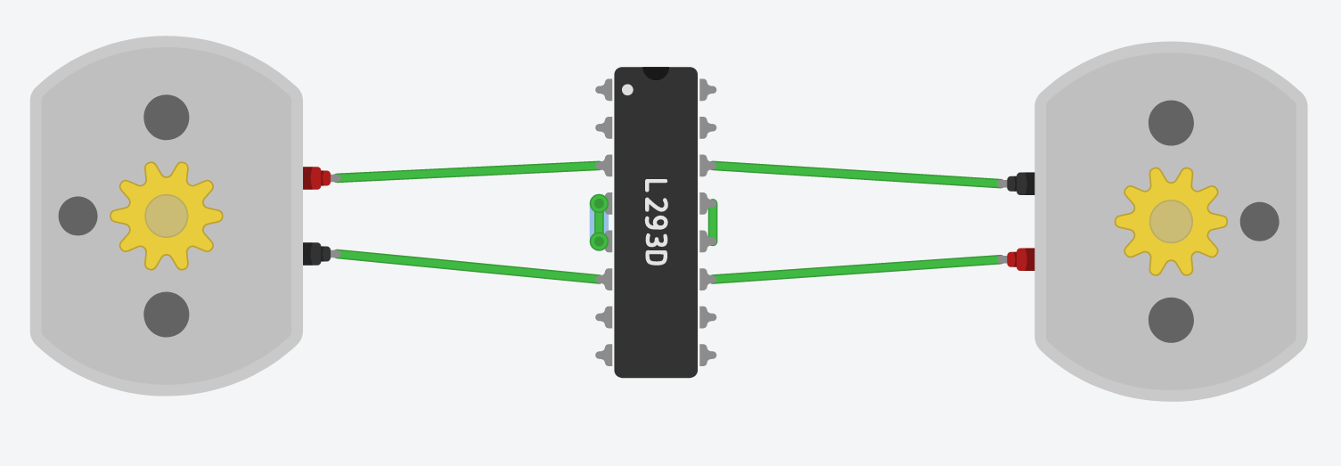
Motor Driver Diagram
Logic Power
Ground
Ground
input
Motor Power
Left Motor
Right Motor

Slide 22
Power Design
5V DC
(Strict Regulation)
Logic System
12-6V
(Unregulated)
Drive System

Slide 23
Power for Logic System
Raspberry Pi
Two Li-ion battery in series
5V Voltage Regulator
Motor Driver Logic

Slide 24
Remote Control System
Button Press
Remote Controller
Transmitter
Receiver
Logic Processor
Power
Left wheel
Motor Driver
Right Wheel
Remote Device
Car

Slide 25
Remote Control Algorithm
Start
Start
Start
Scan for Keypress
Scan for Keypress
Scan for Keypress
Left/right
Left/right
UP
Left/right
UP
Determine Key
UP
Determine Key
Turn Right or left
Determine Key
Go Forward
Turn Right or left
Go Forward
Turn Right or left
Go Forward
No Keypress
No Keypress
No Keypress
No Movement
No Movement
No Movement
Continue for
0.5 sec
Continue for
0.5 sec
Continue for
0.5 sec
Repeat from start

Slide 26
Result and Limitation
The car successfully drives over straight, left and right turns
The car is able to accommodate additional sensors
Though this requires multithreading programming, which is more complex. So it will be worked on future implementation.
The car is very slow
Detection and processing takes long time. Need to use powerful processor.
Remote control works. But single press is processed at any moment.

Slide 27
Video with Explanation
Google Drive link: https://drive.google.com/file/d/1PJA7G-LvgrDHkBlLhBRDVgVZ1TRDPb1S/view?usp=sharing

Slide 28
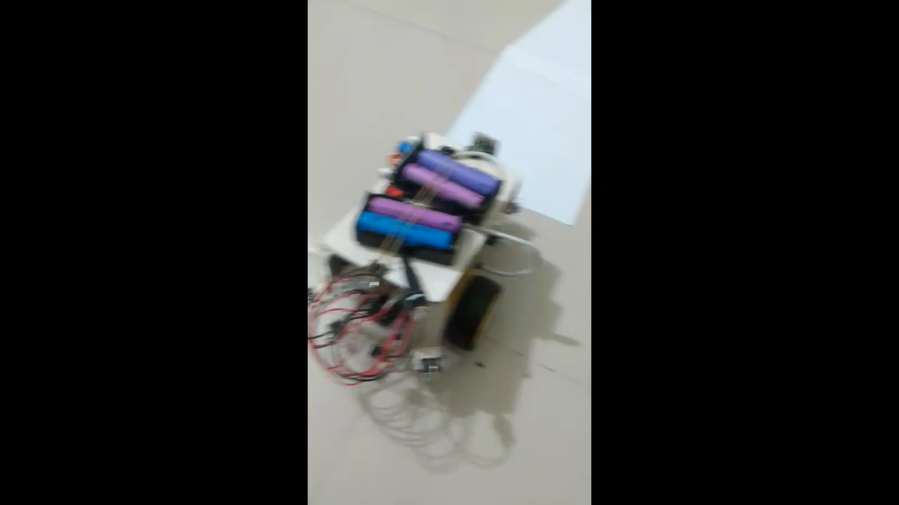

Slide 29
References
[1] Hummel, R., “Image enhancement by histogram transformation”, ieht.rept, 1975.
[2] J. P. Gonzalez and U. Ozguner, "Lane detection using histogram-based segmentation and decision trees," ITSC2000. 2000 IEEE Intelligent Transportation Systems. Proceedings (Cat. No.00TH8493), Dearborn, MI, USA, 2000, pp. 346-351, doi: 10.1109/ITSC.2000.881084.
[3] P. Pramkeaw and C. Thongchaisuratkrul, “Automated Driving System of Lane Detection Using Image Processing Techniques”, International Journal of the Computer, the Internet and Management Vol.27 No.1 (January-April, 2019) pp. 58-63
[4] Gurjashan Singh Pannu, Mohammad Dawud Ansari and Pritha Gupta. Article: Design and Implementation of Autonomous Car using Raspberry Pi. International Journal of Computer Applications 113(9):22-29, March 2015

Slide 30
References (continued)
[5] N. P. Pawar and M. M. Patil “Driver Assistance System based on Raspberry Pi”, International Journal of Computer Applications (0975 – 8887),Volume 95– No.16, June 2014
[6] Raja Muthalagu, Anudeepsekhar Bolimera, V. Kalaichelvi, Lane detection technique based on perspective transformation and histogram analysis for self-driving cars, Computers & Electrical Engineering, Volume 85, 2020, 106653, ISSN 0045-7906, https://doi.org/10.1016/j.compeleceng.2020.106653. (https://www.sciencedirect.com/science/article/pii/S0045790620305085)

Slide 31
References (continued)
[7] HSV cylinder, Page url:
https://commons.wikimedia.org/wiki/File:HSV_color_solid_cylinder.png, file URL: https://upload.wikimedia.org/wikipedia/commons/4/4e/HSV_color_solid_cylinder.png, attribution: SharkD, CC BY-SA 3.0 <https://creativecommons.org/licenses/by-sa/3.0>, via Wikimedia Commons. Date taken: 14 April,2021
[8] https://www.allaboutcircuits.com/technical-articles/introduction-to-histogram-equalization/
[9] https://www.murtazahassan.com/courses/self-driving-car-using-raspberry-pi/lesson/finding-curve/

Slide 32
Thank you.
Questions and Answers

